Slide 1
Immigration to BNA 1815-1850
How 2 key immigration events
impacted the colony
Notes:
Great Migration 1815-1850; involved over 800,000 immigrants

Slide 2
Brainstorm all of the different reasons why people would move to BNA at this time
Consider:
PUSH factors (emigration): events that are forcing people to leave their country
PULL factors (immigration): events/opportunities that are drawing and attracting people to a new country

Slide 3
The Great Migration

Slide 4
Why was it “Great”?
It is estimated that 800,000+ people immigrated to BNA at this time
They primarily came from:
England
Wales
Scotland
Ireland

Slide 5
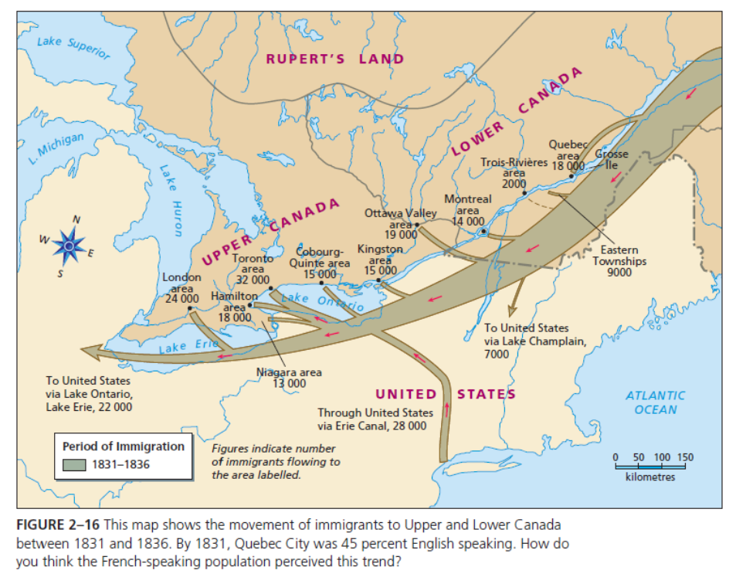

Slide 6
Transatlantic Voyage
What was the immigrant experience across
the Atlantic Ocean like?

Slide 7
Key Ideas of the Great Migration
Could take years for people to save up the money to make the voyage
Voyage could take anywhere from 6 weeks to 3 months
Poor lived in steerage (below deck)
Overcrowded and filthy
Lack of food, water, sanitation
Wrought with disease, such as typhus and cholera; hence the nickname “coffin ships”
Notes:
Horizons pp. 23-25

Slide 8
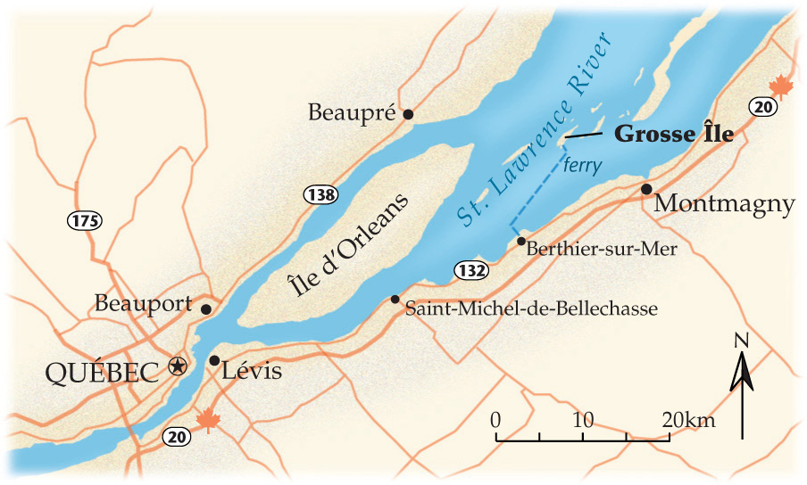
Grosse Ile
Notes:
Used from 1832 to 1937, then switched to immigration officers at airports/train stations

Slide 9
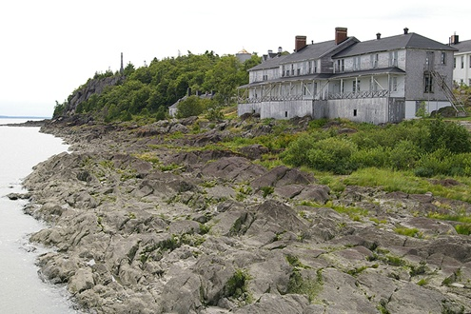
Upon first arrival…
immigrants arrived at Grosse Ile to be inspected for illness and disease before they were allowed to enter Upper and Lower Canada
Notes:
Created in 1832
After the massive wave of immigrants in 1847, barracks were built to house the sick and quarantined; however before that, tents were used

Slide 10
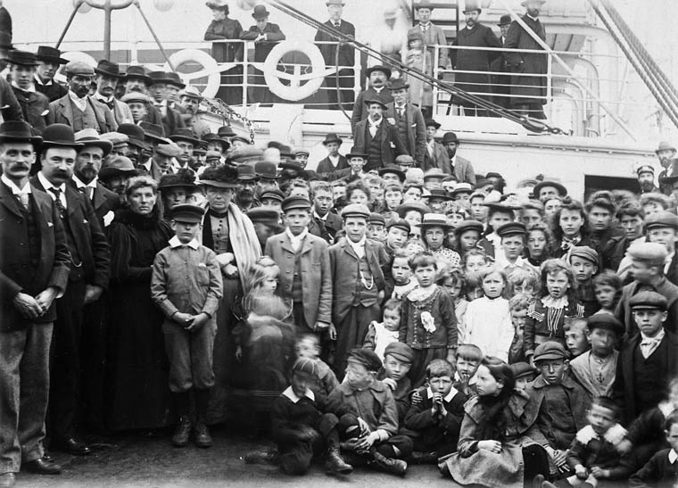
What was its purpose?
Ships were quarantined from 1-3 weeks if ill passengers were found on board
Grosse Ile was originally built to house 200 in the hospital and 800 in quarantine
Notes:
Immigrants arriving in 1902 to Gross Ile

Slide 11
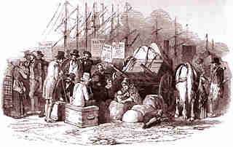
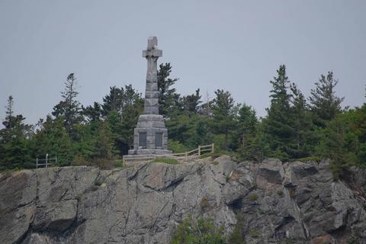
1847 was a busy year
The Irish Potato Famine in 1847 produced a wave of immigration and Grosse Ile was overrun
By June the facilities were full, so people had to stay on board with the sick and dead
Up to 85 deaths/day
Notes:
Irish Potato Famine 1845-1848-49 (the height was 1847)
Usually 25,000 – 30,000 immigrated per year; during 1847, 100,00 came in a single season!!
5 000 people died at sea, and 5 424 people were buried at Grosse Île
Irish Memorial on Grosse Ile to commemorate the dead (typhoid epidemic)
320 health practitioners died on Grosse Ile
It is estimated that 40% of the French Canadian population is of Irish descent!

Slide 12
Heritage Minute – “Orphans”

Slide 13
“Underground Railroad”
Notes:
“Railway” is a network of secret routes and safe houses to get to freedom

Slide 14
Key ideas of the Underground Railroad
Secret network of trails, pathways, and safe houses
Use songs and codes to share information
Quakers, Methodists, and abolitionists aided slaves to freedom
Settled in Upper Canada, Lower Canada, New Brunswick, and Nova Scotia
While they gained freedom, Black slaves from the south did not find acceptance in BNA society
Lived as communities within communities
Notes:
Horizons pp. 28-29

Slide 15
Slave Trade Laws
1793 – Upper Canada Lieutenant Governor Simcoe passes an Act that abolishes slavery
1833 – Slavery is abolished in the British Empire
1850 – Fugitive Slave Act (passed by the American gov’t)
If a slave escaped to a “free” state, they would no longer be safe
Masters could find their slaves and claim them back as property
Anyone who aided slaves to get to freedom would be fined $1000 and sent to jail for 6 months
Now, to get to true freedom, slaves would need to escape to British North America (BNA)
Notes:
Aiders and abetters of slaves received 6 months in jail and a $1000 fine

Slide 16
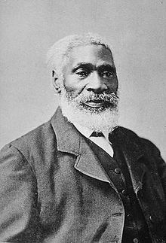
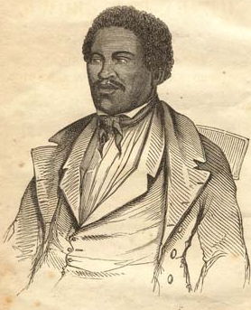
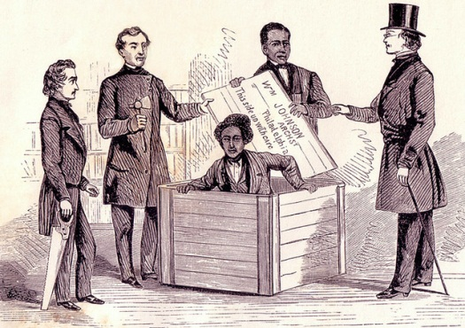
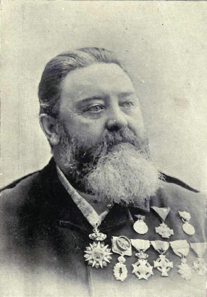
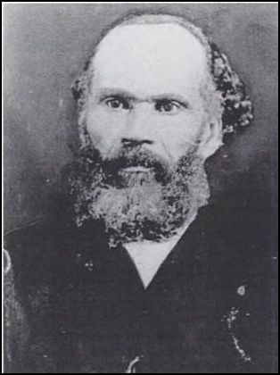
Important People of the Underground Railroad
Harriet Tubman
Josiah Henson
Henry “Box” Brown
Alexander Milton Ross
Abraham Doris Shadd
Notes:
Harriet Tubman – born into slavery 1820 in Maryland; ran away in 1849; rescued family and non-relatives from plantation slavery; most famous “conductor” of the Underground Railroad; lived in Upper Canada for a period of time (St. Catharine’s, Ontario)
7 minute video on Harriet Tubman - http://www.biography.com/people/harriet-tubman-9511430
Josiah Henson – born into slavery in Maryland; escaped and settled in Upper Canada (Dresden, Ontario) in 1830; established a settlement and school to educate free slaves
Henry “Box” Brown – born into slavery in Virginia 1815; escaped to Philadelphia; during the trip, which began on March 23, 1849, Brown's box traveled by wagon, railroad, steamboat, wagon again, railroad, ferry, railroad, and finally delivery wagon. Several times during the 27-hour journey, carriers placed the box upside-down or handled it roughly, but Brown was able to remain still enough to avoid detection; once the Fugitive Slave Law was passed in 1850, he moved to England
Alexander Milton Ross - born in Belleville, Upper Canada and died in Detroit, Michigan, USA. He was an abolitionist who was an agent for the secret Underground Railroad slave escape network, known in that organization and among slaves as The Birdman for his preferred cover story as a bird enthusiast.
Abraham Doris Shadd - By the late 1820s Shadd was a "conductor" on the Underground Railroad from his homes in Wilmington, Delaware and later West Chester, Pennsylvania. From those homes fugitive slaves would travel the "railroad" to freedom in Canada. Shadd hid escaping slaves and provided them with food, clothing, and guidance as they made their way north; in the early 1850s he moved to Upper Canada; he became the first Black Canadian to serve in public office (show students the stamp!); daughter is Mary Ann Shadd (see text p. 30/ p. 62 2nd edition)

Slide 17
Heritage Minute – Underground Railroad

Slide 18
Immigration to BNA 1815-1850
Created by Ms. C. Ross
Socials 10
Updated February 2015

