Slide 1
Ruben’s Career Path
How to become a chartered accountant

Slide 2
My Career Goals
I want to become a chartered accountant by 2025
To get there, I will need to:
Graduate high school by June 2020
To achieve this I will have to graduate high school with good enough grades to get accepted into university
Then I would have to take one year off of school to make money to pay for my education

Slide 3
What is a chartered accountant?
The job of a chartered accountant is to work with their Clients which include corporations, governments, and individuals where they have to work with financial document's which that clients are required to disclose by law
Things that accountants have to do regularly include a wide range of accounting, auditing, tax, and consulting task for their clients.

Slide 4
About my future career
This job can be done from an office if you decide to work for a company or it can also be done at home
The salary range for this job is anywhere from 35k at the low end to 99k at the high end of earning
The average hours for this job are 9am – 5 pm, with a usual total typical work week of 40 hours

Slide 5
My job has a 93.5% chance of becoming automated
Tax planning is a large aspect of accounting that cannot be automated because It requires the accountant to create a plan for the future of their clients in order to pay the least amount of tax possible which is one reason why accounting or at least a portion if it wont become automated
Small business owners require advise from their accountants on managing their business finances which is another reason why it wont become automated

Slide 6
My compatibility
I am 85% compatible with this job.
The skills this job requires are: organization, time management, communication skills, adaptability, analytical skills and math skills

Slide 7
Accounting would be great for me because…
I already have these skills for this career: In my opinion I think that I already have great attention to detail
I have fairly good computation skills
I have a good ability to work with numbers in my head

Slide 8
I am not quite ready for this career, but I will get there!
These are skills for the job I still need to learn:
Time management
Leadership
This is how I will get those necessary skills:
I will work on my time management by rewarding myself with free time when I complete tasks on time
My leadership skills are decent however I need to work on my ability to work well with others

Slide 9
Job Outlook
In BC, the job outlook is 3 out of 3 stars.
Here are 2 reasons why: The first reason why it has a 3 out of three star rating is because of how well at the high end earing you would earn 99k per year.
The second reason why it has such a good rating is because you can do accounting work from either your home of from an office which makes it very convenient to do and get done.

Slide 10
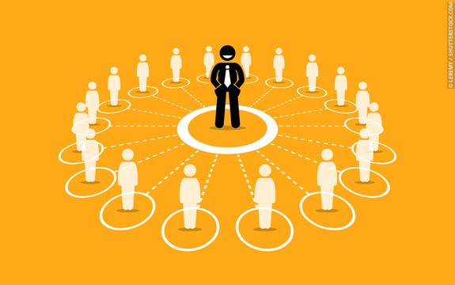
This is what appeals to me with this career…
This career appeals to me because I am good at working with numbers and I can see my self enjoying it if I decide to work for myself
Also the amount of money that I could earn if I am an accountant allows me to live a comfortable lifestyle without having to stress about money
Lastly I think that I would find it fun to create financial plans for company’s which would help them into the future. I would enjoy that because if the plan I created works I would feel very accomplished in knowing that I helped influence it.

Slide 11
These are some things I find less appealing about this career…
The thing that I find less appealing about this job is that even though I enjoy working with numbers it would become very repetitive having to work for hours on end doing the exact same task
Another thing that isn’t very appealing about this job is that if a do turn out to work for myself I would have to work many more hours than if I were to be employed by an accounting firm

Slide 12
Potential obstacles to getting this career
The possible obstacles:
Not doing well enough in school
Not being able to pay for the expensive schooling
My plan to overcome them:
Make sure to study hard and prioritize it over socializing with friends
Take a year of to work so that I can save enough money to pay for my tuition

Slide 13
Potential obstacles to being successful within this career
The possible obstacles:
Not working hard enough to do better than the people I am competing with
Getting to comfortable with the position that I an in
My plan to overcome them:
Always make sure to be on time and get my assigned work done ahead of when it should be done
Set goals that I want to achieve by he end of each year and if I achieve them I can reward myself

Slide 14
The training/education required for my career is:
Chartered accountants are required to have a university degree along with 30 months of on the job training and a completion of a professional training program approved by the province institute of chartered accountants

Slide 15
I intend to go to Douglas college for this career
It is located in coquitlam, British Columbia
The program that I will be taking is Bachelor of Business Administration - Accounting
The length of this program is 4 years
When I complete this program I will receive a Bachelor of Business Administration diploma
The only education that is required is the completion of high school

Slide 16
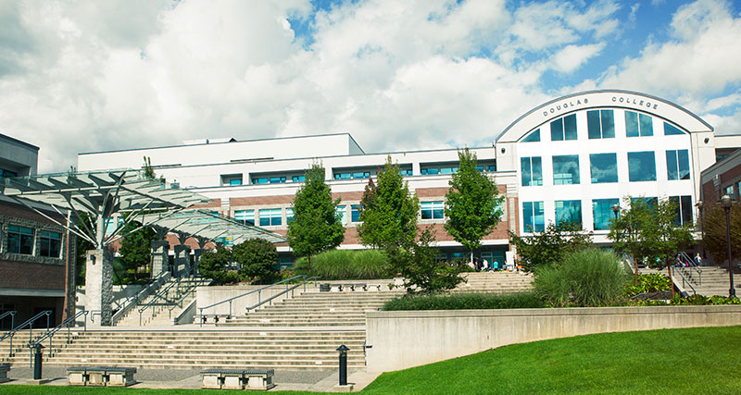

Slide 17
High school courses required
Grade 11 courses:
Pre-calculus 11
Grade 12 courses:
English 12
A minimum of 60% is required in all prerequisite courses

Slide 18
Admission requirements: A minimum of 60% is required in all prerequisite courses
They are known for the amazing accommodations they have for people who have disabilities and that they provide the support they might need
The reason why I decided that I want to go study at Douglas college is because it is close by so I do not have to pay for room and board

Slide 19
Financial Plan
Total cost of this program is $22, 714.4
I am going to pay for my program:
In grade 12 I will apply for as many bursaries that I can effectively manage at one time so that I can get as much of my tuition covered as possible, My parents have also agreed to pay for half of my education. The rest I am currently saving for and I will take a year off between high school to work full time and save money to pay for it within a year. I will put that money into a savings account that I may not use freely which is meant for my education. My ultimate goal is to graduate with no student debt.

Slide 20
Some related occupations:
Two related occupations are being a risk management specialist, and a credit analyst

Slide 21
Accountants are awesome!!!
Three things that really excite me about this career are helping people make better financial decisions that will help grow their businesses or companies, working on my own time if I am self employed and the skills that I will have could be used on other areas than just accounting

